Slide 1
COVID-19 Pandemic Epidemiological and Clinical overview
Sherif B. Mossad, MD, FACP, FIDSA, FAST
Section of Transplant Infectious Diseases, Respiratory Institute
Cleveland Clinic
Professor of Medicine
CCLCM of CWRU
Disclosure: Member of Cleveland Clinic COVID-19 Research prioritization committee

Slide 2
COVID-19 Pub Med Publications since January 2020
> 5,000

Slide 3
Outline
The virus
Pathogenesis
Comparison to other coronavirus outbreaks & a few other infections
Epidemiology
Clinical Presentation
Diagnosis
Prevention
Treatment
Road to recovery

Slide 4
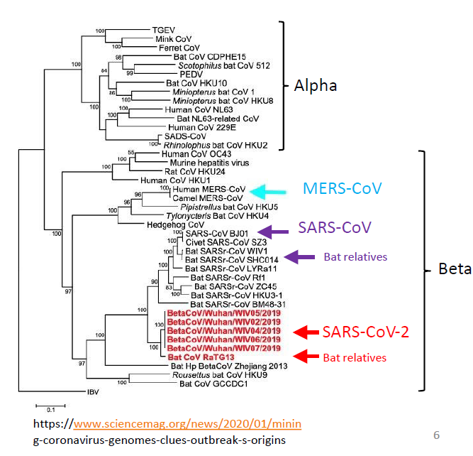
Meet the enemy

Slide 5
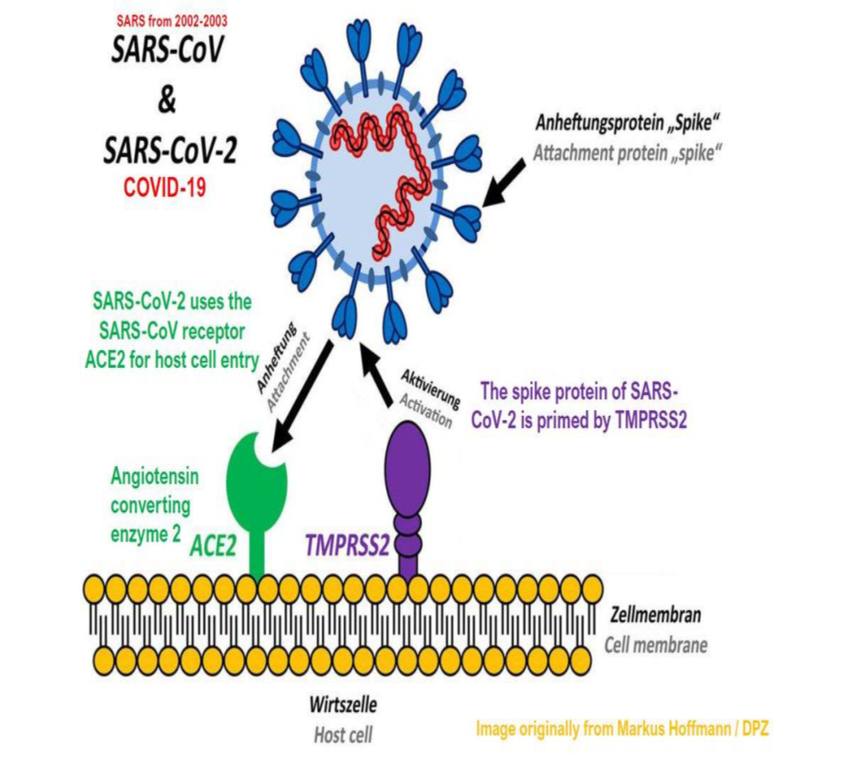
Where does it start invading the body?
Hoffmann M. Cell 2020Cell, DOI: 10.1016/j.cell.2020.02.052

Slide 6
Comparing SARS – MERS – COVID-19
 | SARS | MERS | COVID-19
Years | 2002 - 2003 | 2012 → | 2019/20 → ?
Pandemic duration | 8 months | Sporadic | 4.5 months*
Country of onset | China | Saudi Arabia | China
Animal hosts | Bats → civets | Bats → camels | Bats → civets?
Countries affected | 26 | 27 | 210*
Cases | 8,437 | 2,499 | 2,235,837*
Deaths (%) | 813 (10%) | 861 (35%) | 153,516 (6.7%)*
*As of April 17th, 2020

Slide 7
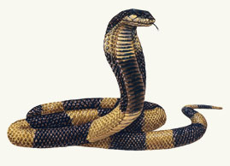
Comparing SARS – MERS – COVID-19
SARS | MERS | COVID-19
8 months to infect 8000 & kill 800 | 12 months to infect 100 & kill 30 | 4.5 months to infect 2.2 million & kill 150,000

Slide 8
How Contagious is SARS-CoV-2?
 | Reproductive number “R₀ “: How many people can one infected person transmit the infection to a susceptible population? | Secondary household attack rate
SARS-CoV-2 | 2-3 | 10%
Influenza | 1.2 | 1-38%
Measles | 12-18 | ≥ 90%
Varicella zoster | 10 | 85%
Tuberculosis | 10 per year | ≥ 50%

Slide 9
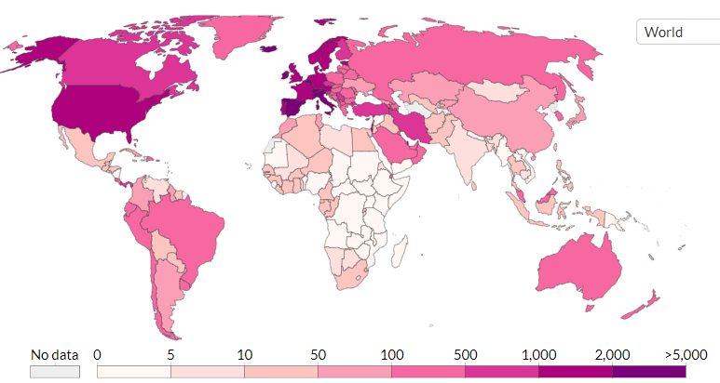
Global Epidemiology
https://ourworldindata.org/grapher/total-confirmed-cases-of-covid-19-per-million-people

Slide 10
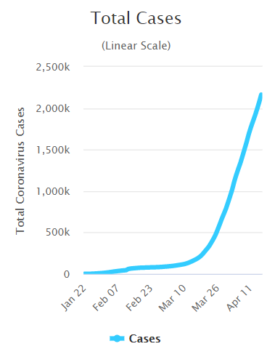
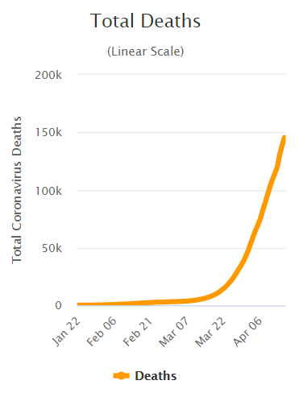
Global Epidemiology
https://www.worldometers.info/coronavirus/

Slide 11
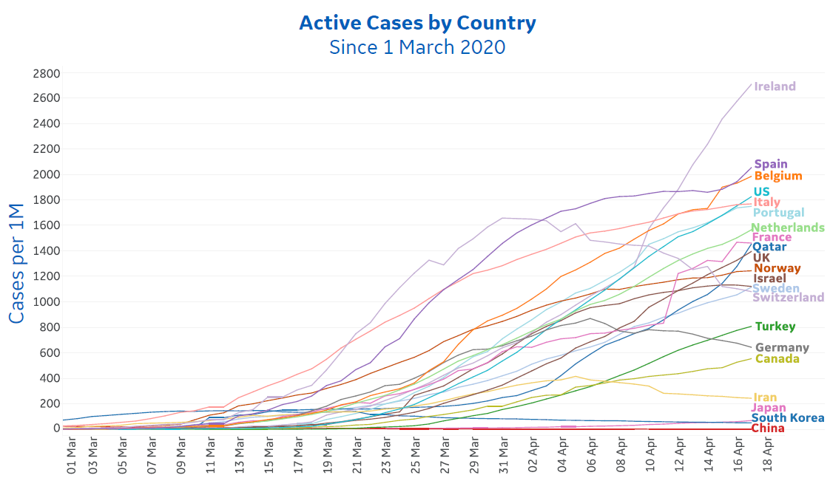

Slide 12
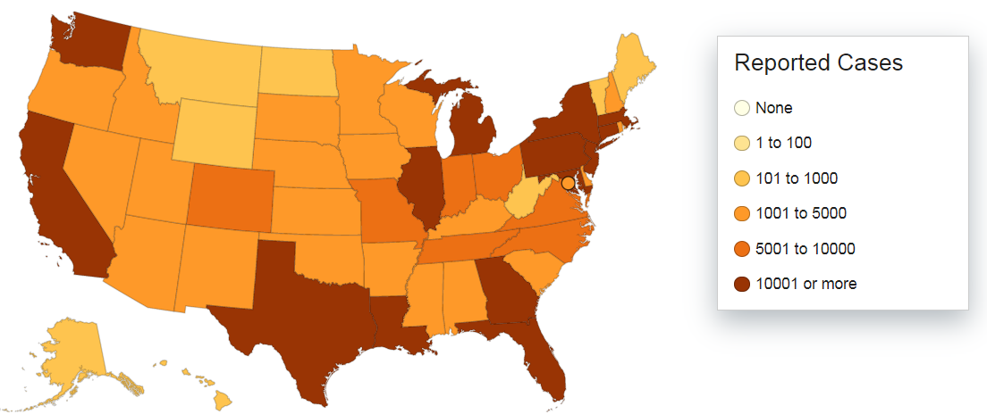
USA Epidemiology
https://www.cdc.gov/coronavirus/2019-ncov/cases-updates/cases-in-us.html#anchor_1586782138

Slide 13
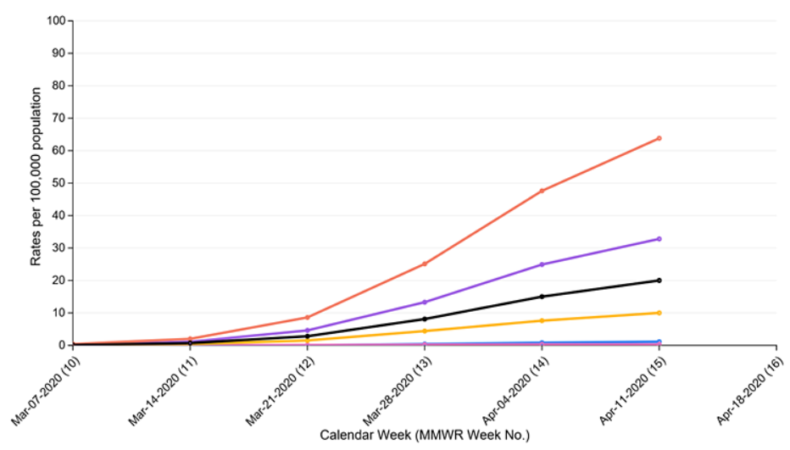
USA Hospitalizations
Age
65 + yr
50-64 yr
Overall
18-49 yr
0-4 yr & 5-17 yr
https://www.cdc.gov/coronavirus/2019-ncov/covid-data/covidview/index.html

Slide 14
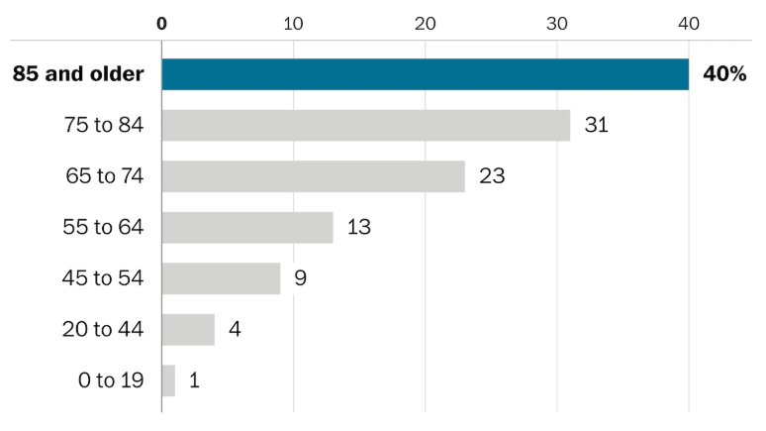
USA Percent Mortality Among Hospitalized by Age
https://www.washingtonpost.com/national/health-science/medical-databases-show-1-in-10-hospitalized-middle-aged-coronavirus-patients-in-us-do-not-survive/2020/04/11/284485a2-7bfe-11ea-b6ff-597f170df8f8_story.html

Slide 15
USA Number of Deaths Over Time
https://www.cdc.gov/nchs/data/health_policy/Provisional-Death-Counts-COVID-19-Pneumonia-and-Influenza.pdf

Slide 16
Focusing on Health Care Settings
What Constitutes Close contact?
a) Being within approximately 6 feet (2 meters), of a person with COVID-19 for a prolonged period of time (such as caring for or visiting the patient); or
b) Having unprotected direct contact with infectious secretions or excretions of the patient (e.g., being coughed on, touching used tissues with a bare hand).
https://www.cdc.gov/coronavirus/2019-ncov/hcp/guidance-risk-assesment-hcp.html

Slide 17
Exposure Risk Categories in Health Care Settings
High | Medium | Low
Prolonged close contact with patients with COVID-19 who were not wearing a facemask while HCP nose and mouth were exposed to potentially infectious material. |  | Brief interactions with patients with COVID-19 or prolonged close contact with patients who were wearing a facemask for source control while HCP were wearing a facemask or respirator. Use of eye protection, in addition to a facemask or respirator would further lower the risk of exposure
Being present in the room during aerosol generating procedures, or when respiratory secretions are likely to be poorly controlled (e.g., CPR, intubation, extubation, bronchoscopy, nebulizer therapy, sputum induction) when the HCPs’ eyes, nose, or mouth were not protected. | HCP who were wearing a gown, gloves, eye protection and a facemask (instead of a respirator) during an aerosol-generating procedure.

Slide 18
Transmission to Health Care Personnel in California
121 Exposed
14 High risk
80 Medium risk
27 Low risk
43 (36%) Symptoms
3 (7%) Positive SARS-CoV-2 PCR
2 High risk
1 BiPAP
1 BiPAP + intubation
1 Medium risk
No AGP
Heinzerling A. MMWR Morb Mortal Wkly Rep. 2020;69:472–476.

Slide 19
Infected USA Health Care Workers’ Exposure Settings
Only health care | 780 (55%)
Only household | 384 (27%)
Only community | 187 (13%)
Multiple | 72 (5%)
No data on health care workers’ specialties
CDC COVID-19 Response Team. MMWR Morb Mortal Wkly Rep 2020;69:477–481.

Slide 20
Medical Specialties of 23 Health Care Workers who died from COVID-19 in China
13 physicians:
5 practiced in community health centers or in private clinics
3 practiced Chinese medicine
2 internal medicine physicians
2 physicians in respiratory medicine
1 was a gastroenterologist
8 were surgeons
3 ophthalmologic surgeons
1 electrocardiography technician
1 nurse
No anesthesiologists listed
Zhan M. N Engl J Med; April 15, 2020 DOI: 10.1056/NEJMc2005696

Slide 21
Prediction Models for Diagnosis and Prognosis of COVID-19 infection
31
3
Hospitalization
18 Diagnostic (13 machine learning based on CT)
10 Prognostic (LOS, severity, mortality)
“Poorly reported, at high risk of bias, and their reported performance is probably optimistic.”
Wynants L. BMJ 2020; 369 :m1328

Slide 22
Environmental Stability of SARS-CoV-2
van Doremalen N. N Engl J Med 2020; 382:1564-1567

Slide 23
Clinical Presentation
Mild 80%, moderate 15%, severe 5%
Influenza-like illness (fever, cough, dyspnea [4-8 days from onset])
Huang C. The Lancet, 2020,395(10223):497 - 50
Nausea, diarrhea, abdominal pain (20%)
Cheung KS. Gastroenterology 2020 (https://doi.org/10.1053/j.gastro.2020.03.065)
Loss of sense of smell & taste (60%??)
Menni C. MedRxiv 2020.04.05.20048421; doi (not peer-reviewed)
Acute respiratory distress syndrome
Matthay MA. Lancet Respiratory Medicine DOI:https://doi.org/10.1016/S2213-2600(20)30127-2
Encephalopathy, agitation, confusion & corticospinal tract signs (14%)
Hemls J. N Engl J med DOI: 10.1056/NEJMc2008597
Hypercoagulable state
Zhou F. Lancet 2020;395(10229):1054-1062

Slide 24
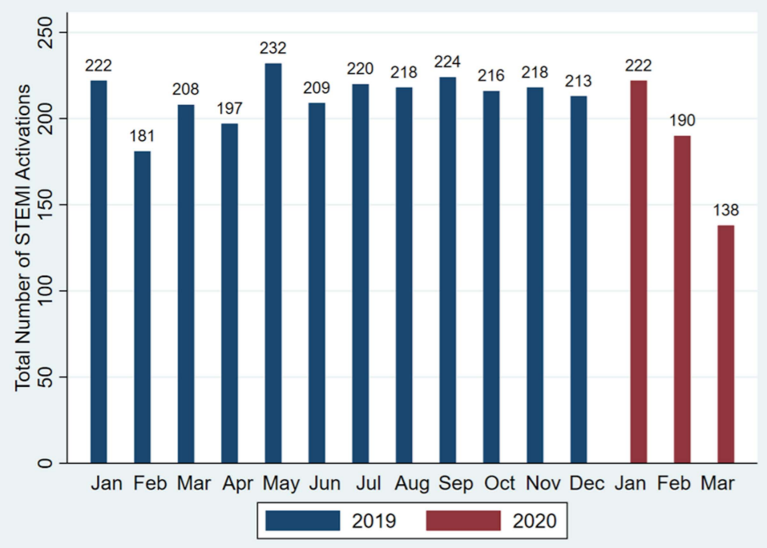
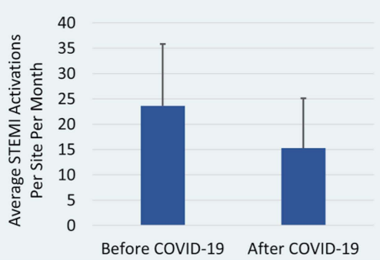
Collateral Damage: Reduction in ST-Segment Elevation Cardiac Catheterization Laboratory Activations in the United States during COVID-19 Pandemic
38%
Garcia S. J Amer Col Cardiol 2020, doi: https://doi.org/10.1016/ j.jacc.2020.04.011

Slide 25
Asymptomatic / Presymptomatic SARS-CoV-2 infection
 | 1%
 | 1.8%
243 cases
157 locally acquired
1/23/20 – 3/16/20
10 (6.4%)
Transmission occurred from an asymptomatic / presymptomatic person to a secondary patient before the source patient developed symptoms, with no evidence that the secondary patient had been exposed to anyone else with COVID-19.
Ng O-T. N Engl J Med 2020; 382:1476-1478
Hoehl S. N Engl J Med 2020; 382:1278-1280
Wei WE. MMWR Morb Mortal Wkly Rep 2020;69:411–415.

Slide 26
Study of a case with mild illness & 16 contacts in USA
Case
PCR +ve |  |  | 18 days
Cough | 16 days
Date | 1/20/20 |  | 1/22/20 |  | 2/5/20 |  | 2/7/20
16 Contacts
11 High risk
1 Intimate
2 Household
3 Healthcare
5 Rideshare
5 Medium risk
PCR
35 specimens
(1-7/person)
All -ve
Scott SE. Clin Infect Dis https://academic.oup.com/cid/advance-article/doi/10.1093/cid/ciaa374/5815221

Slide 27
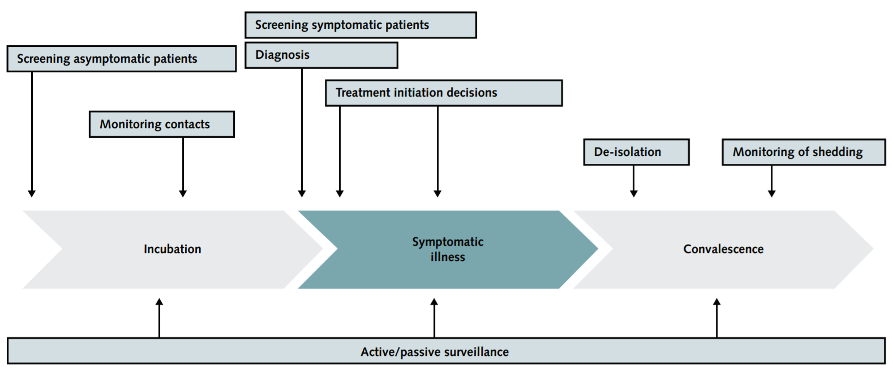
Diagnostic tests: a continuum of care
Cheng MP. Ann Intern Med. doi:10.7326/M20-1301

Slide 28
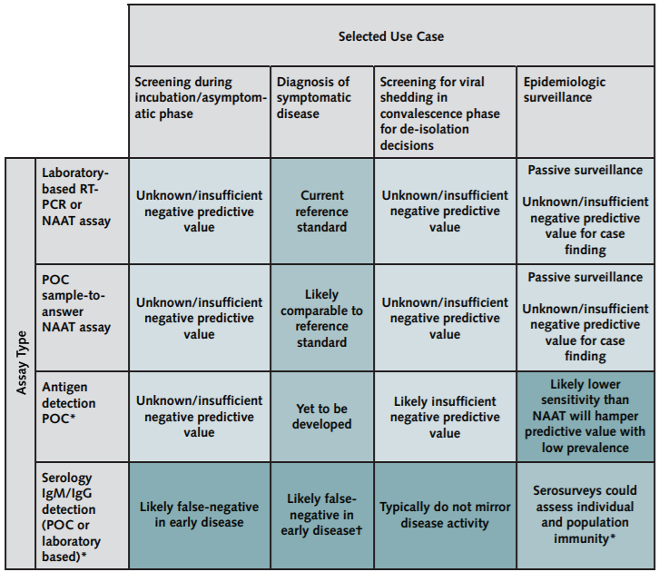
Cheng MP. Ann Intern Med. doi:10.7326/M20-1301

Slide 29
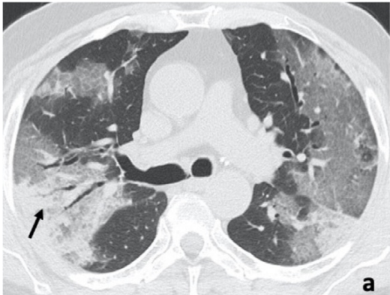
Chest CT
CT Features | % present
Ground Glass Opacity | 100%
Multilobe involvement | 93%
Bilateral distribution | 91%
Posterior Involvement | 93%
Peripheral GGO location | 89%
Subsegmental vessel enlargement (> 3 mm) | 89%
Diagnostic Performance with RT-PCR as the standard of reference:
Sensitivity 97%, Specificity 56%, Positive predictive value 59%, Negative predictive value 96%, Accuracy 72%
Caruso D. Radiology https://pubs.rsna.org/doi/pdf/10.1148/radiol.2020201237

Slide 30
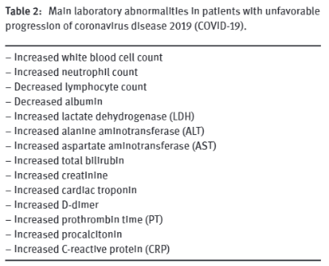
Laboratory abnormalities
Lippi G. Clin Chem Lab Med. DOI: https://doi.org/10.1515/cclm-2020-0198.

Slide 31
Respiratory Copathogens
Pathogen | % positive
Rhinovirus/enterovirus | 6.9%
Respiratory Syncytial virus | 5.2%
Other coronaviridae | 4.3%
Metapneumovirus | 1.7%
Influenza A | 0.9%
Parainfluenza virus 1 | 0.9%
Parainfluenza virus 3 | 0.9%
Parainfluenza virus 4 | 0.9%
Total | 20%
Kim D. JAMA. Published online April 15, 2020. doi:10.1001/jama.2020.6266

Slide 32
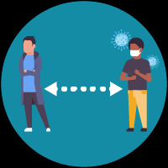
Prevention
Hand washing
Social distancing
Cough & sneeze etiquette
Masking
Disinfecting surfaces
Stay home if sick
Beware of unsubstantiated claims
https://www.cdc.gov/coronavirus/2019-ncov/prevent-getting-sick/index.html

Slide 33
mRNA-1273
Phase 1 clinical trial (safety & immunogenicity)
Healthy volunteers, 18-45 years
Washington Seattle
6 weeks
Expected availability for public use 12-18 months
https://www.nih.gov/news-events/news-releases/nih-clinical-trial-investigational-vaccine-covid-19-begins

Slide 34
How to treat COVID-19
Mild: supportive care
Moderate / severe:
Supportive care
No FDA approved medications / biological products

Slide 35
Infectious Diseases Society of America Guidelines on the Treatment and Management of Patients with COVID-19
Hospitalization | Hydroxychloroquine/chloroquine in the context of a clinical trial
 | Convalescent plasma in the context of a clinical trial
 | Hydroxychloroquine/chloroquine + azithromycin only in the context of a clinical trial
 | Combination of lopinavir/ritonavir only in the context of a clinical trial
 | Tocilizumab only in the context of a clinical trial
Hospitalization for pneumonia | Against the use of corticosteroids
Hospitalization for ARDS | Corticosteroids in the context of a clinical trial
Bhimraj A. Clin Infect Dis https://www.idsociety.org/practice-guideline/covid-19-guideline-treatment-and-management/

Slide 36
IDSA Guidelines on the Treatment and Management of Patients with COVID-19: “Other”
Darunavir/cobicistat: No
Lopinavir-ritonavir + interferon beta or other antivirals: “being evaluated”
Convalescent plasma for prophylaxis: “study opened”
Ribavirin: No. Inconclusive or harm for SARS-CoV-1 and MERS-CoV
Oseltamivir: No. Neuraminidase enzyme not found in coronaviruses
Intravenous immunoglobulin: No. Studies needed in communities with increasing numbers of people recovering from COVID-19
Remdesivir: Awaiting studies. Termination of viral RNA transcription (Ebola virus, MERS-CoV & SARS-CoV-1). Compassionate-use in COVID-19 pneumonia: improvement 68%, mortality 13% & acceptable toxicity profile.
Should NSAIDS be stopped? No
Should ACE and ARBs be stopped? No
Bhimraj A. Clin Infect Dis https://www.idsociety.org/practice-guideline/covid-19-guideline-treatment-and-management

Slide 37
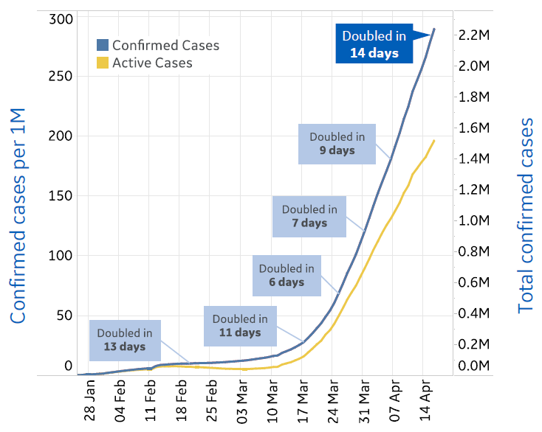
A Reason for Hope: Doubling of Doubling Time

Slide 38
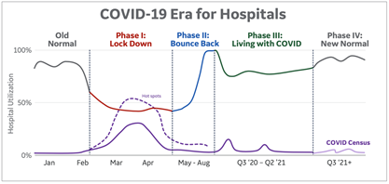
Road to Recovery. Responsible “Bounce Back”
Widespread Testing
Cohorting
Restructured waiting rooms
Risk-stratified catch-up
Maintain appropriate physical distancing
Employee support
PPE supply chain
Effective Treatment & Prevention
Current
https://www.idsociety.org/contentassets/9ba35522e0964d51a47ae3b22e59fb47/idsa-recommendations-for-reducing-covid-19-distancing_16apr2020_final-.pdf

Slide 39
Take Away Points
Information moving at the speed of light
Beginning to understand the virus biology & epidemiology
Mostly human to human droplet transmission
Proportion of asymptomatic / presymptomatic transmission unclear
Prevention through behavioral measures + vaccine development
Treatment supportive + clinical trials
Reason for hope and road to recovery

